Slide 1


HR ORBIT
Performance
Appraisal

Slide 2

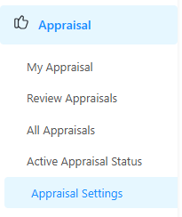
Appraisals

Slide 3
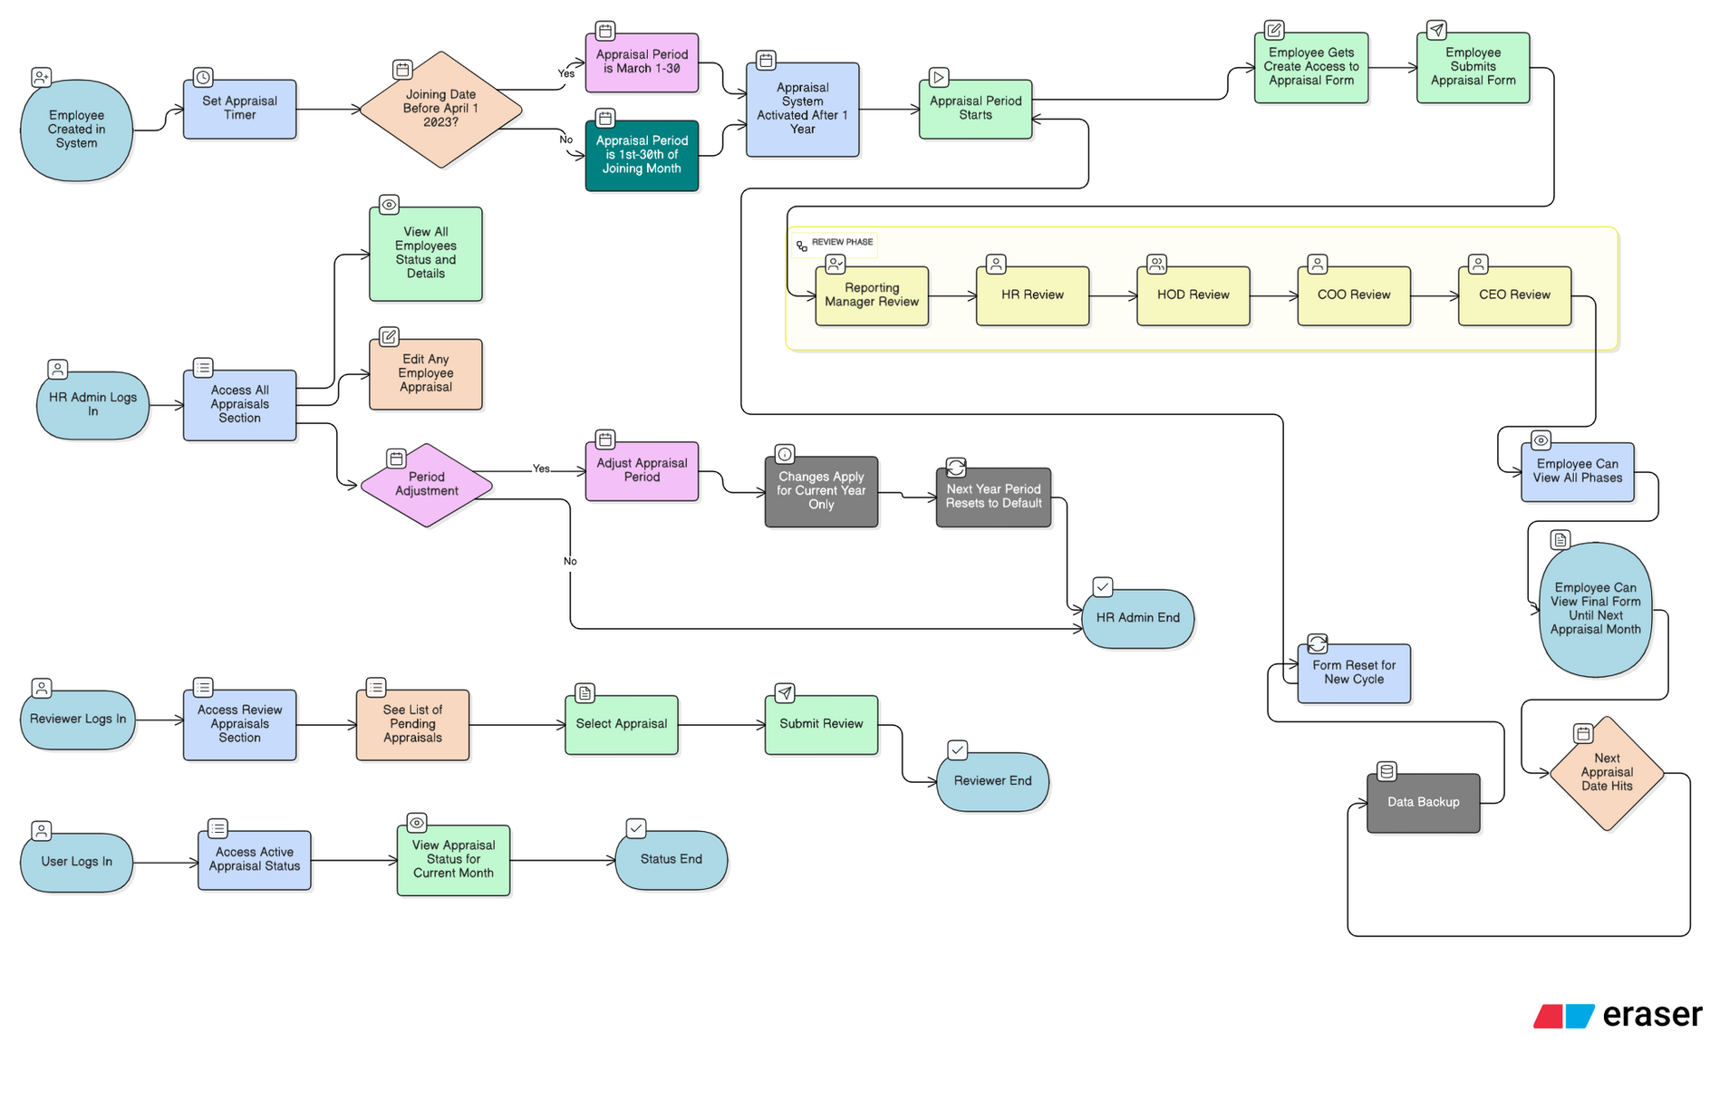

Slide 4

ThankYOu!!

